Slide 1

Partnering with
Community Pharmacists to Better
Prepare and Respond in an Emergency
Andy Stergachis, PhD, RPh, School of Public Health
and
Don Downing, RPh, School of Pharmacy

Slide 2
Learning Objectives
Identify opportunities and challenges in working with community pharmacists for emergency preparedness and response.
Describe how medicines and pharmacy services might be useful in preventing and responding to emergency events.
Describe how to build effective partnerships with pharmacists for emergency preparedness and response.

Slide 3




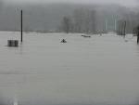

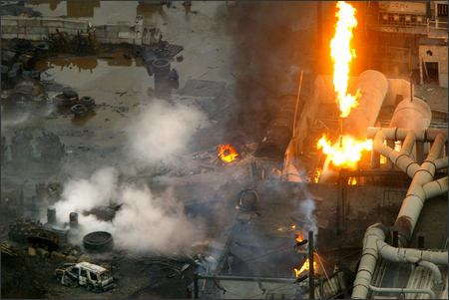

Emergencies Will Happen, Will You Be Ready?

Slide 4
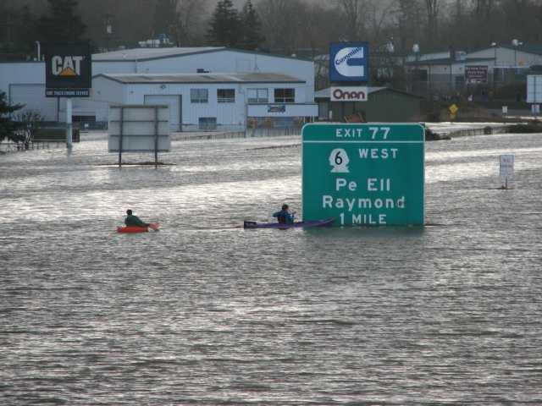
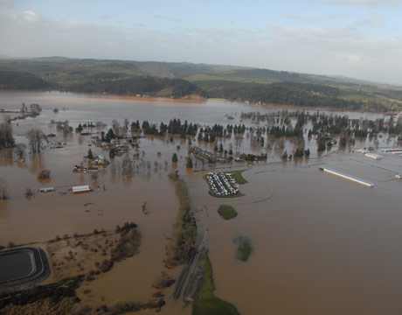
“Twenty miles of Interstate 5 in Lewis County were closed and the state expected to close another stretch of the freeway north of the Puyallup River Bridge near Fife.” (01/08/2010)
Pictures from 2007

Slide 5
What are the Consequences?
Impact communities
  People – health, safety, mental well-being
    (Ourselves, Families, Workers, Clients, customers, suppliers)
  Infrastructure (roads, power lines, water/sewer, communications)
  Critical systems and industries (healthcare, food, civil order, trade, tourism)
  Employment

Slide 6
Can You Guess Who This Is?
At times, not treated as if in the mainstream – not always invited or to have a seat at the table as equal partners in emergency preparedness
Underutilized and, at times, underappreciated
Often have less challenging actual responsibilities than what education prepared them for
Passionate about their communities and families

Slide 7




Slide 8
Pharmacists are one of the nation’s most accessible and trusted health professionals
Located in virtually every community
Third largest health professional group
Among the most trusted professionals in the country
Practicing in expanded roles
Often the first healthcare providers contacted by patients, particularly when persons seek advice on over-the-counter treatments for flu-like illnesses.
Medicines are among the most important interventions for health maintenance and promotion

Slide 9
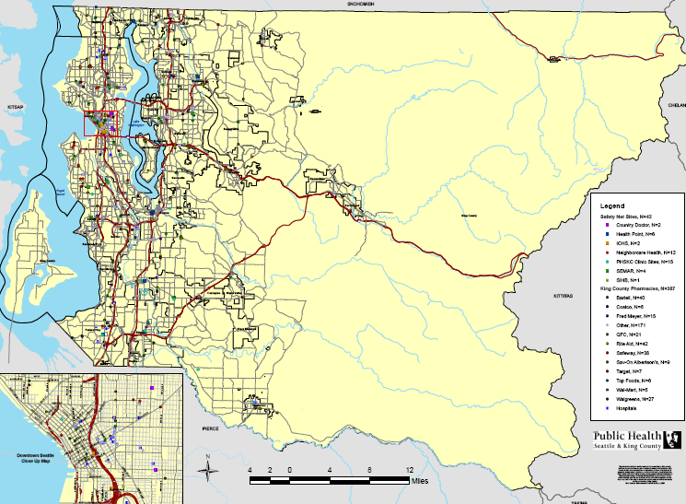
Know Where Your Pharmacies Are

Slide 10
Identifying community needs: Which of these may be a threat to your community?
Category A§ Bioterrorism Agents | Countermeasures (Prevention: post-exposure prophylaxis (PEP)) | Countermeasures (Treatment)
Anthrax (Bacillus anthracis) | 60 days antibiotics after last exposure plus 3 doses of BioThraxT vaccine. Antibiotics for PEP (one of the following may be administered): Ciprofloxacin* Doxycycline* Levofloxacin Gatifloxacin | 60 days antibiotics, one of the following: Ciprofloxacin* Doxycycline* Levofloxacin Gatifloxacin
Tularemia (Francisella tularensis) | 14 days of treatment, after last exposure (one of the following may be administered): Ciprofloxacin* Doxycycline* Levofloxacin Gatifloxacin | 10-14 days of treatment with one of the following: Streptomycin* Gentamicin* Ciprofloxacin* Levofloxacin Gatifloxacin 14-21 days of treatment with one of the following: Doxycycline Chloramphenicol*
Influenza Viruses | Countermeasures (prevention: post-exposure prophylaxis (PEP)) | Countermeasures (treatment)
Influenza Type A¥ | Oseltamivir (Tamiflu®) Zanamivir (Relenza®) | Ideally, begin treatment within 2 days of becoming ill: Oseltamivir (Tamiflu®) Zanamivir (Relenza®)

Slide 11
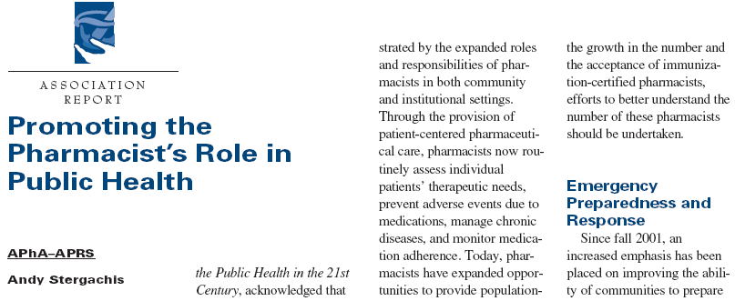
Immunization programs
Emergency preparedness and response
Contraceptive services
Prevention & control of diseases & injuries
J Am Pharm Assn. 2006;46:311-14

Slide 12
So What Are the Roles for Pharmacists in Emergency Preparedness?
Planning
Detection and Reporting of Events
Communication
Emergency Response
Personal Preparedness & Business Continuity

Slide 13
Discussion
Sharing of stories of working with pharmacists

Slide 14
Example: Windstorm 2006
EXTREMLY heavy rain for Puget Sound
Wind gusts up to 70 mph occurred across the Puget Sound Region
Combination of saturated soils and wind gusts caused widespread tree damage
1.2 million lost power – from a few hours to two weeks
Cold temperatures followed the front

Slide 15
Windstorm 2006 – Real World Event
11 hospitals in King County lost power, most restored in 24 hours (1 was out for 6 days); 75% of nursing homes lost power
Nursing homes sought alternate housing for their clients (massive evacuations)
Hundreds of restaurants and grocery stores lost power (potential for food borne illness)
Cold, hungry people resorted to alternate methods to keep warm and fed (hundreds ill, ten deaths)

Slide 16
Local Public Health Response Activities During the 2006 Windstorm
Warn Public of Health Risks:
  Messages: Carbon Monoxide, Toxic Asphyxiation, Food-Borne Illness
  Language Translation
  Reach Vulnerable Populations
Protect the Medically Fragile:
  Telephone contact
  Special Needs Shelter
Investigate Illness/Deaths
Sustain Critical Public Health Functions
Notes:
16

Slide 17
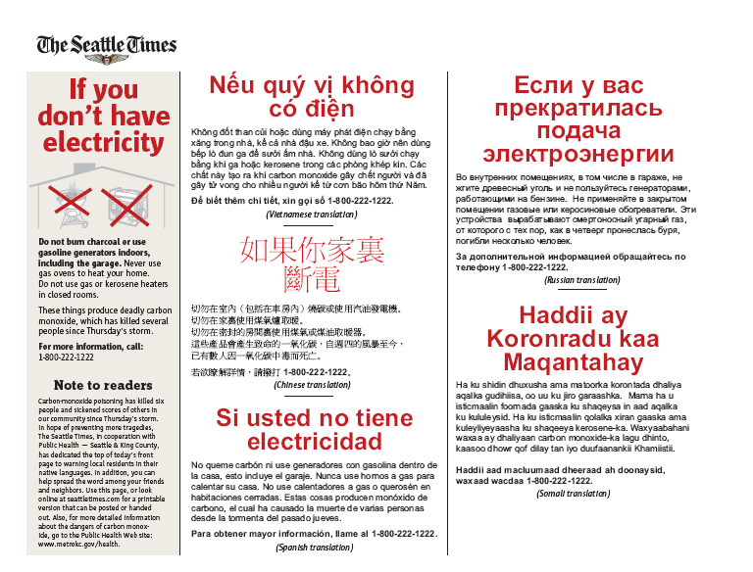

Slide 18
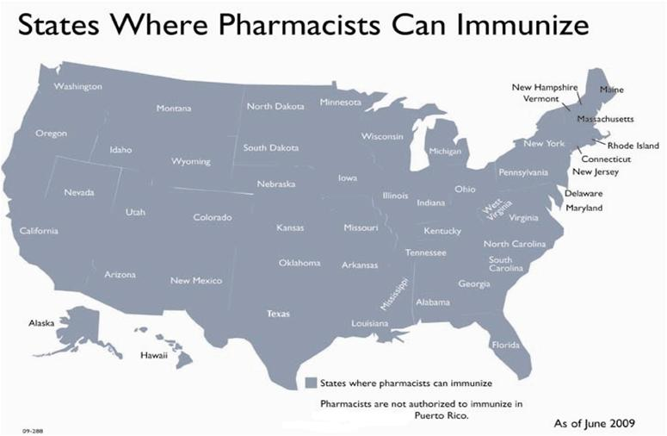
www.pharmacist.com
Notes:
Here is how the state looks for CDTA – according to this July’s Pharmacist’s Letter
The States I listed as Conditional are listed as such because their CDTA are limited to health systems, or pharmacists can modify therapy but not initiate therapy.

Slide 19
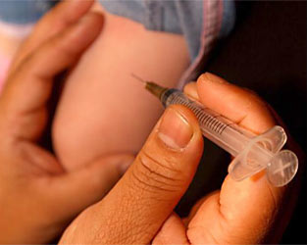
Routine Adult and Adolescent Immunizations
Diphtheria*
Tetanus*
Pertussis*
Measles +
Mumps+
Rubella +
Varicella
Pneumococcus
Influenza
*Td or Tdap
+ MMR

Slide 20
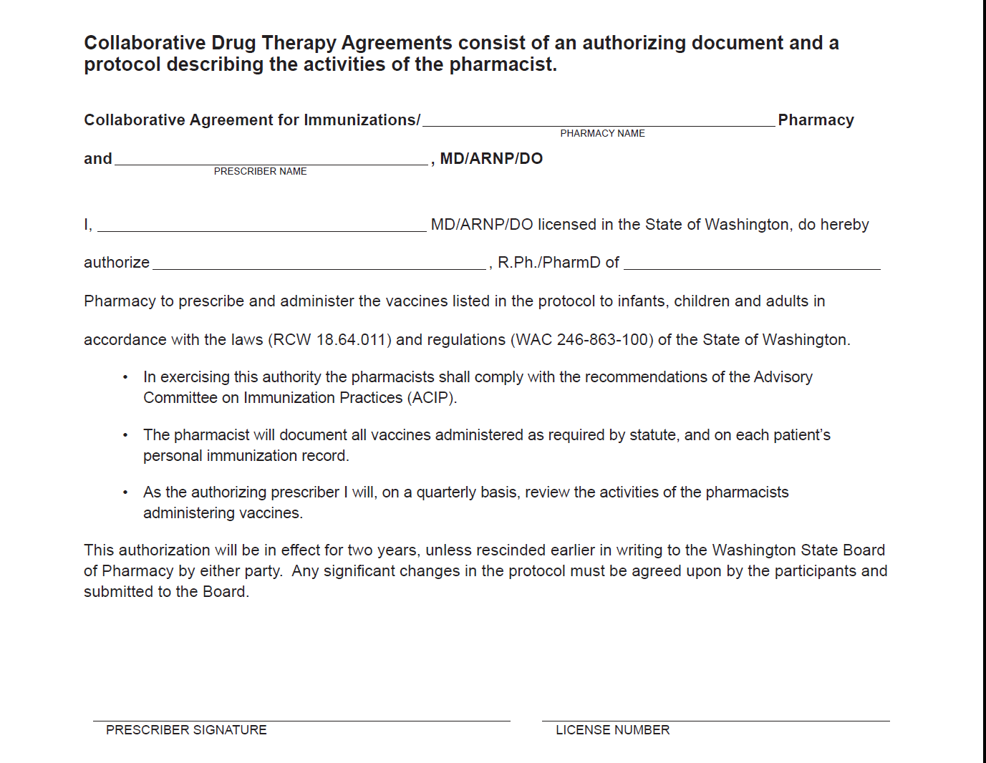
Collaborative Drug Therapy Agreement: State of Washington
Notes:
Here is one of the simplest

Slide 21
Collaborative Drug Therapy Agreements are in Common Use
Medication Management in hospitals
Travel Clinics
Immunization Services
Anticoagulation Clinics
Cholesterol Clinics
Antivirals for Influenza Outbreaks
… there are over 1,300 on file with the Board of Pharmacy in the State of Washington

Slide 22
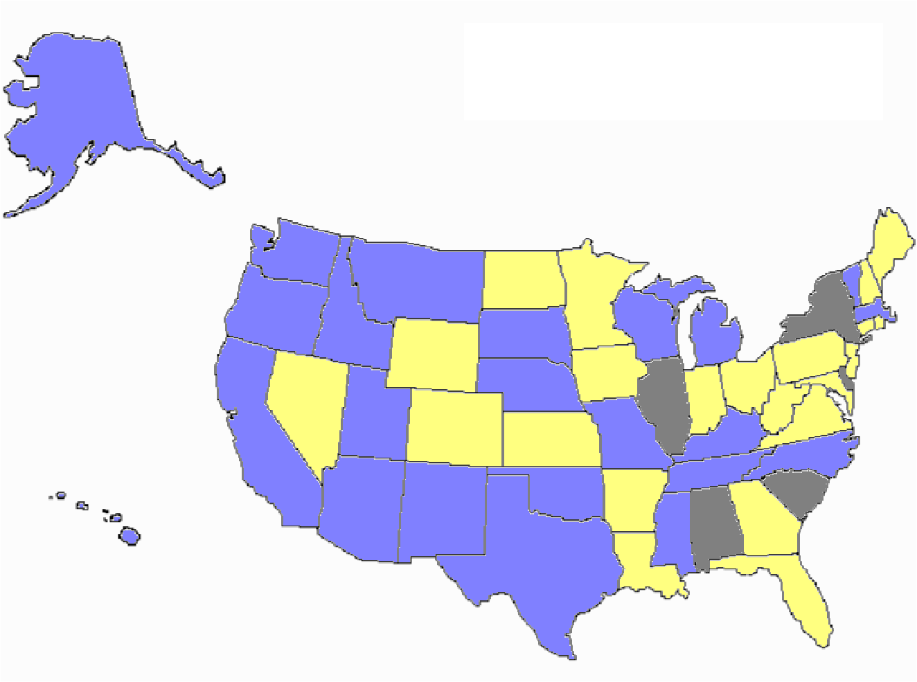
Collaborative Drug Therapy Agreements
CDTA
Conditional CDTA
No CDTA
Pharmacist's Letter 2009; 25(8):250801

Slide 23
Roles for Pharmacists - Revisited
Role in an emergency will depend upon:
  The type of event
  The role of defined in “any” existing plans
  Skills, knowledge, availability
Could include:
  Pharmaceutical distribution
  Immunizations / Mass prophylaxis
  Adverse event reporting
  Communications
Through workplace and/or Public Health Reserve Corps
Personal preparedness and business continuity

Slide 24
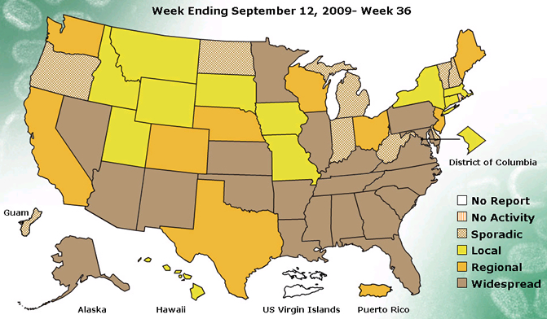
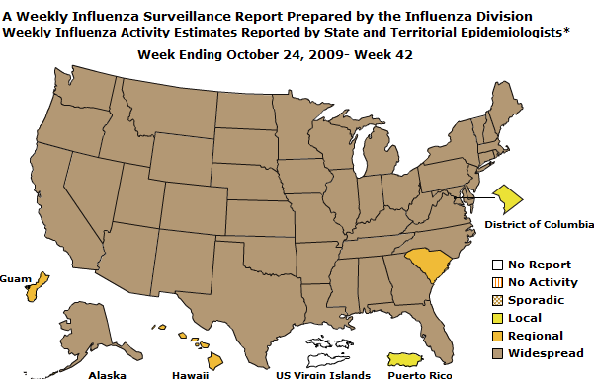
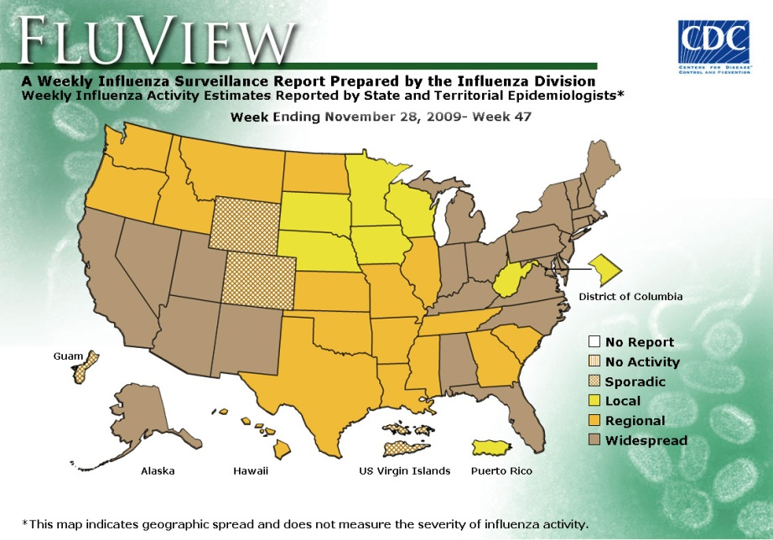
Widespread Influenza Activity 2009
http://www.cdc.gov/flu/weekly/
Week ending Sept 12, 2009

Slide 25
Potential Impact of Pandemic Influenza
Vaccine and antiviral drugs - short supply
Healthcare workers and other first responders will be at higher risk of exposure and illness than the general population.
Risk of sudden shortages of key personnel in critical community services
Medical care system overwhelmed

Slide 26
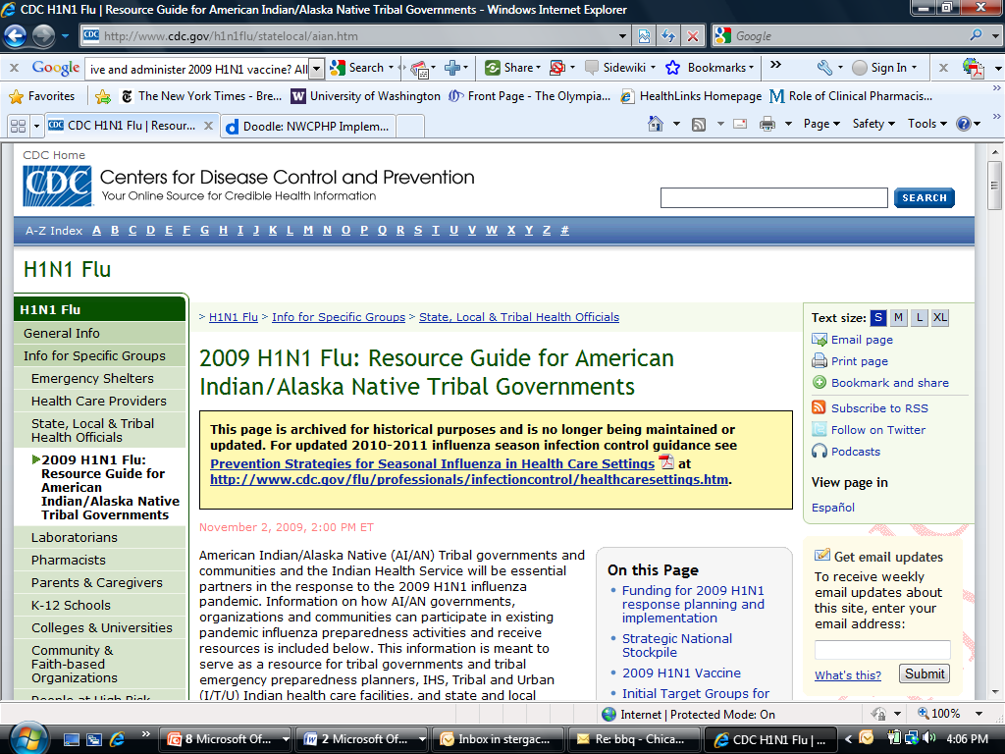
Guidance for healthcare personnel employed in IHS, Tribal and Urban facilities and for the general population for distribution of:
  Antivirals
  N-95 respirators
  H1N1 vaccine
www.cdc.gov/h1n1flu/statelocal/aian.htm

Slide 27
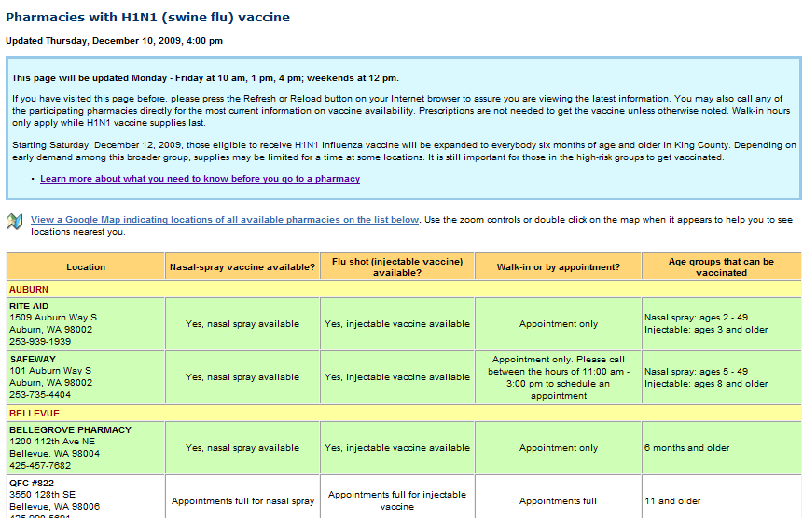

Slide 28
Pharmacy Considerations for H1N1 Response
Ordering and receiving vaccine
Patient screening and consent
Formulation
Vaccine Information Statement
Thimerasol notice
Adverse reactions - VAERS
Public education
Reporting
Administrative fee

Slide 29
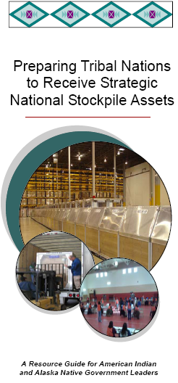

Slide 30
Planning for the SNS
American Indian / Alaska Native governments and communities
Designate a lead tribal liaison with the authority to speak on behalf of the tribe to help coordinate inter-agency responses and negotiate agreements with other state and local partners
Identify roles and responsibilities for people involved in emergency planning and response
Develop plans, procedures, and guidelines consistent with neighboring community agencies
Define what public health resources exist in the community and determine what support will be needed from sources outside the community
Identify at-risk or vulnerable community members who may have special needs during a public health emergency
Create mutual aid agreements that help with the exchange of resources and information between agencies during emergencies
Exercise an SNS response plan

Slide 31
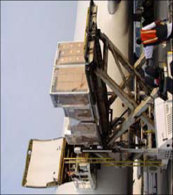
Strategic National Stockpile
Managed by the CDC, the Strategic National Stockpile (SNS) is a large stock of medicines and supplies designed to support public health agencies during a public health emergency.
The decision to deploy SNS assets is a joint effort among state, local, territorial, tribal and federal officials that begins when the health of a community is threatened.

Slide 32
Strategic National Stockpile
Expected to begin arriving within 24 to 36 hours, after a federal decision has been made to deliver assets.
If the nature of the public health emergency is not known, a variety of medicines and supplies will be sent in the form of a 12-hour Push Package

Slide 33
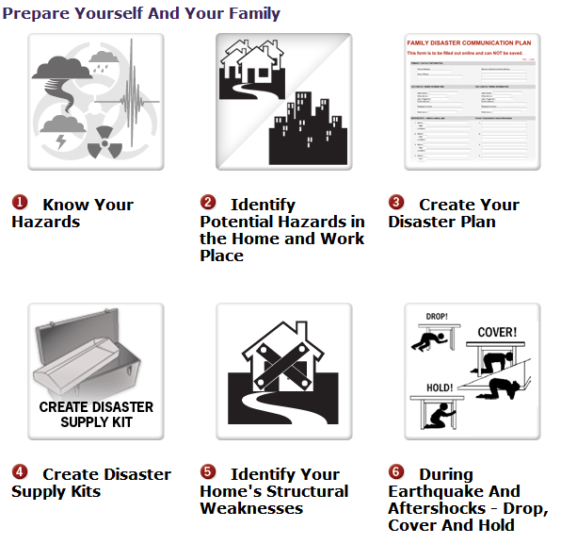
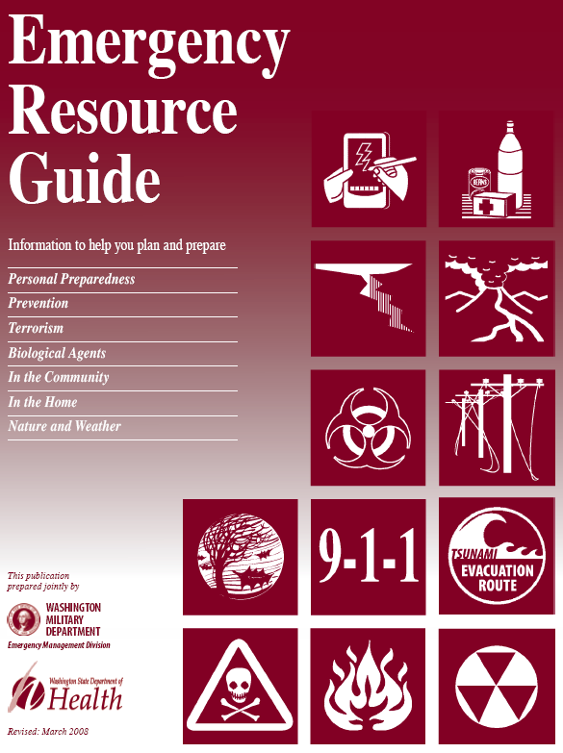
Personal Preparedness
Source: UW Emergency Management http://www.washington.edu/emergency/prepare/
Source: State of Washington Military Department and Washington State Department of Health
Notes:
Emergency Preparedness and Business Continuity Planning
Copyright 2008 - TRIUMF and UW SPHCM - 2008 SRA Meeting
33

Slide 34
Scenario Presentation and Group Discussion During the discussion…
Assume the scenario is real
Make decisions based on available information
View the scenario through your role
Focus on identifying opportunities and barriers in working with public health agencies in preparing and responding to the scenario
Notes:
Moderator should remind the audience that this is a no-fault, low stress environment

Slide 35
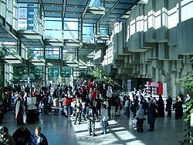
Day 1: Suspicion
A Convention Center security guard believes she recognizes a conference attendee from a conference held two weeks earlier
At a lunch break, the security guard notices the same conference attendee emerging from a building maintenance room. Calling out to the attendee, he flees through the nearest exit

Slide 36
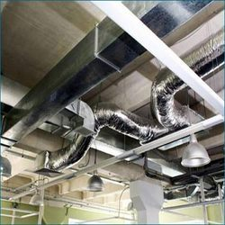
Day 1: Recognition
The security guard approaches the building maintenance room and observes a broken lock, suggesting forced entry
Unsure if anything suspicious occurred, the security guard contacts building maintenance
  Building maintenance explains that the room houses access to the Convention Center’s main ventilation system, which has been experiencing difficulties the last few hours

Slide 37


Day 1: Alerting Authorities
The security guard contacts her supervisor, who agrees that law enforcement officials should be notified
Building maintenance notices an unmarked aerosol can in the trash

Slide 38

Day 1: Public Health Alerted
Law enforcement notifies the local public health department and it immediately authorizes testing at the DOH lab
The lab test returns with a presumptive positive finding for anthrax
A team is dispatched to the site to conduct further environmental testing
  The discarded aerosol can is collected for testing
  Samples of the agent, taken from around and in the ventilation system, are collected for more sensitive and specific confirmatory testing at the state lab. Results will take 1-2 days.
Bacillus anthracis
Image source: CDC
Notes:
Directions
Discuss the need to assess who and how many were exposed.
Discuss the possibility of people exposed who are not Seattle residents.
Note
Note that once testing starts in the lab any initial PCR rest results on clinical specimens require at least six hours. Confirmatory testing will take an additional 18-24 hours.

Slide 39

Day 1: Initial Response Discussion
Local health department directs implementation of mass dispensing plans.
Pharmacies are requested by the health department to mobilize for mass prophylaxis of the public in response to this event
The targeted size of the population for mass prophylaxis is about 70,000 persons
Notes:
Supplemental Information
If evidence suggests a true anthrax exposure has occurred, it is likely that the public health department will make recommendations to initiate antibiotic treatment of persons exposed even though the confirmatory results from lab tests are not yet available.

Slide 40
Day 1: Discussion Questions
What is the preferred method of communicating with the pharmacy community in assisting with providing antibiotics for mass prophylaxis?
How would having an agreement in place assist in providing mass prophylaxis to the community?

Slide 41

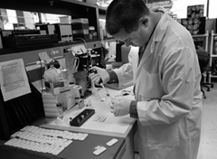
Day 2: Anthrax Confirmed
The state lab confirms anthrax as the substance released
The Emergency Operations Center (EOC) and the public health emergency operations plan are activated
Mass dispensing operations for post-exposure prophylaxis (antibiotics and vaccine) are implemented
Notes:
Directions
Reference Anthrax Fact Sheet in Folders
Supplemental Information
The confirmed dispersion of anthrax spores will likely cause inhalation anthrax, the most severe of the 3 types of anthrax. In 2001, 50% of the inhalational anthrax cases ended in death.

Slide 42
Day 2: Discussion Questions
How would you decide which pharmacies/pharmacists to contact?
Notes:
Supplemental Information
Ask participants to consider if it would be better to include community pharmacies or hospital pharmacists
Do pharmacies feel like they have enough supplies in-stock to manage the response that will be needed? If no, would that influence their willingness to participate in a CDTA? How would they request more antibiotics/communicate the need for more antibiotics (at this early stage)?

Slide 43

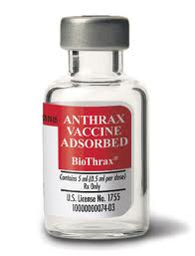
Day 2: Activation
The collaborative drug therapy agreement for antibiotics (ciprofloxacin, doxycycline, and penicillin) is activated
PHSKC indicates that the FDA-approved vaccine – Bio-Thrax® , be included in the mass prophylaxis program; it ontains no live or dead bacteria, made from a non-virulent strain of Bacillus anthracis

Slide 44
Day 2: Discussion Questions (continued)
What barriers do you foresee in working with community pharmacies? In implementing mass dispensing operations in your community?
How should pharmacy and your community interact during this event?
Notes:
Supplemental Information
Where will the mass dispensing clinics be set up?
Who will staff the clinics?
Should there be security at these clinics?
Do you anticipate having enough resources?
How might dosing guidelines change from what is detailed in a CDTA?
Does the pharmacy have a business continuity plan?
How will you communicate mass dispensing sites to the public?
How long do you think it will take to set up mass dispensing sites once the decision is made to set them up?

Slide 45
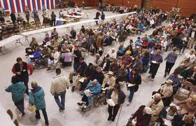

Days 3-7: Mobilizing Mass Dispensing
A pharmacy retailer, which has multiple locations in the County, agrees to set up mass dispensing sites at 2 of their locations
The County and the Community’s health facility will offer medicines and vaccines to walk-ins

Slide 46
Discussion Questions
How will information regarding mass dispensing clinics be communicated to your community?
Are there any perceived barriers, presently, to this partnership with pharmacies during emergency events?
Moving forward, how can partnerships between your community and pharmacy be strengthened?

Slide 47
So What Are the Roles for Pharmacists in Emergency Preparedness?
Planning
Detection and Reporting of Events
Communication
Emergency Response
Personal Preparedness & Business Continuity

Slide 48
Protect yourself, Serve others
Get training
Ensure your own safety
  Vaccinations
  Teams, procedures
Make sure your own basic needs can be met
  Food, water, shelter
You don’t want to become one of the people needing rescue!

Slide 49
Thank you!
Andy Stergachis, stergach@uw.edu
Don Downing, dondown@uw.edu

